Slide 1


DISTRIBUTED CROWDFUNDING SYSTEM USING BLOCKCHAIN
PANIMALAR ENGINEERING COLLEGE
DEPARTMENT OF COMPUTER SCIENCE AND ENGINEERING
CS8811 PROJECT WORK
REVIEW NO:1
Guide Name: Dr. N.Pughazendi
Team Members : SRIRAM S(211418104269) SRIRAM S(211418104268) PRABAKAR(211418104191) Batch No: C7

Slide 2
Overview of the Project
Charity is considered a moral obligation throughout the world, and a huge amount of money comes into circulation in the name of charity.
In most cases, the charity collection processes are not transparent, and due to this, the charitable organizations struggle to gain donors’ trust and interest.
This apprises the need for a solution to these problems so as to make crowdfunding system and spending transparent for the grantmakers.
This need could be fulfilled by a blockchain-based system. This project is implemented to overcome the drawbacks that exist in the present distribution system. We present a blockchain-based crowdfunding system that aims to provide a transparent, secure, auditable, and efficient system.
This system help charities enlist their names so that the investors can verify the legitimacy of the charities in case they have already invested earlier in order to avoid false/fake charities.

Slide 3
Overview of the Project
Once the charities are listed people can start sending donations where the donations get saved in a smart contract as crypto.
Only the parties that hosted the charity will have access to the donations and only they'll be allowed to withdraw them.
This will only be possible post a particular time frame with restrictions on withdrawal amount and approval.
This happens due to the fact that blockchain limits the external factors to illegally access or change data which is a crucial factor for an organization that is trying to gain the trust of donors.
Once data is entered in the blockchain it can almost never be erased or accessed except the trusted entity.

Slide 4
Literature survey
S.NO | TITLE | TECHNIQUE | ADVANTAGES | DISADVANTAGE
1. | Nonprofit organizations at the crossroads of offline and online fundraising in the digital era: The influence of the volume of target beneficiaries on the success of donation-based crowdfunding through digital platforms | Logistic regression | Highly accurate | Can be expensive and time cosuming

Slide 5
Literature survey
S.NO | TITLE | TECHNIQUE | ADVANTAGES | DISADVANTAGE
2. | A Secured Distributed Ledger Based Fundraising Framework Using Smart Contracts | smart contract applications | By sandwiching a layer of Blockchain Technology between each stakeholder, the project affirms change that empowers people in the right direction. | Can be technically complex for many people to use

Slide 6
Literature survey
S.NO | TITLE | TECHNIQUE | ADVANTAGES | DISADVANTAGE
3. | Developing a Reliable Service System of Charity Donation During the Covid-19 Outbreak | Ethereum blockchain | It provides an automated way of managing the donations and charity events in a trusted and secure manner | Not cost-effective, Can be complex to use by a user

Slide 7
Literature survey
S.NO | TITLE | TECHNIQUE | ADVANTAGES | DISADVANTAGE
4. | Research on Charity System Based on Blockchain | blockchain technology | All transactions are recorded on the blockchain to realize traceability of funds, which increase the transparency of charities | May be time-consuming

Slide 8
Literature survey
S.NO | TITLE | TECHNIQUE | ADVANTAGES | DISADVANTAGE
5. | Platform for Tracking Donations of Charitable Foundations based on Blockchain Technology | Smart Contract | Blockchain approach for safeguarding and integrity | The prototype built shows less precision and work inefficiently

Slide 9
Literature survey
S.NO | TITLE | TECHNIQUE | ADVANTAGES | DISADVANTAGE
6. | Tracking Donations of Charitable Foundations Using Blockchain Technology | Smart Contract | Centered on blockchain technology, the System provides open accounting of operations for donors, charitable foundations, and recipients | May take a lot of time to load and process

Slide 10
Literature survey
S.NO | TITLE | TECHNIQUE | ADVANTAGES | DISADVANTAGE
7. | Blockchain based Trusted Charity Fund-Raising | Blockchain technology | provides safe and secure charity transactions by minimizing third party frauds | The scope of the Blockchain technology is limited due to the unawareness of value of Cryptocurrency.

Slide 11
Literature survey
S.NO | TITLE | TECHNIQUE | ADVANTAGES | DISADVANTAGE
8. | Managing charity 4.0 with Blockchain: a case study at the time of Covid-19 | Smart Contracts | It will store all the transactions on a distributed permissioned blockchain which will be very secure | It May be expensive and have some technical errors

Slide 12
Literature survey
S.NO | TITLE | TECHNIQUE | ADVANTAGES | DISADVANTAGE
9. | Developing a Reliable Service System of Charity Donation During the Covid-19 Outbreak. | Blockchain Technology | The system designed in the project was developed and implemented using Python, Flask framework with capability and ability to handle challenges fraud transactions and can speedily execute blocks and mine within the Blockchain | Reduced data transfer speed

Slide 13
Literature survey
S.NO | TITLE | TECHNIQUE | ADVANTAGES | DISADVANTAGE
10. | Multi-point Fundraising and Distribution via Blockchain | Smart Contracts | Highly secure, high accuracy The copy of each node will be present on several servers which helps us to maintain integrity in the case of an attack or system failure | Not Cost- effective, Takes much time to process

Slide 14
Problem Definition
Charity is a highly growing sector in today’s world and it has evolved from its traditional organizational concepts to a decentralized crypto-currency based system.
In this fast developing world of modernization, some people are becoming too competitive to earn money while others have no clue about getting even a penny.
But at the same time, there exist people who wish to contribute to the society out of altruism.
There exist many online donation platforms in the world and yet issues concerning extra fees, accountability and processing delay still exist as well as these existing centralized systems for charities are so corrupt that people lose belief in these trustless systems and hence the charities become futile.

Slide 15
Existing System
Existing system doesn’t check if the funds collected in the crowdfunding are really legit.
And also, we can’t find whether the funds which are collected are properly is received by the fund collector or not.
The existing system lacks security.

Slide 16
Tools Used
Metamask
Visual studio code

Slide 17
Proposed System
Since every transaction is happening on the blockchain, all the transactions can be tracked.
Also all the transactions can be verified as well.
More transparency can be seen in the funds collected when we are implementing with blockchain.

Slide 18
Feasibility Study
Appropriate experiments were done to evaluate the feasibility of the project in terms of technicality, convenience and economic practicality.
The evaluation results show that the project is technically feasible.
The performance analysis shows that the project provides better accuracy and precision, leading to its feasibility in the performance parameters.
The project is convenient to use and is economically feasible.

Slide 19
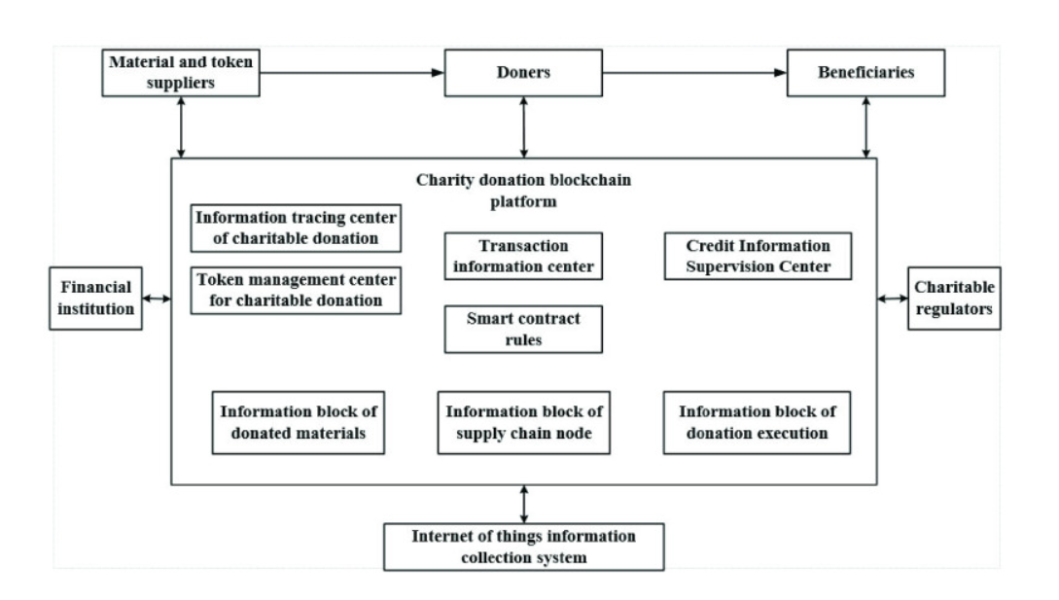
System Architecture

